Slide 1
Retail Sales Analytics Dashboard
Data-Driven Insights for Business Growth
Nandani Rana presents

Slide 2
Agenda
01
Executive Summary
02
Category Performance
03
Statistical Validation
04
Regional Analysis
05
Profit Distribution
06
Time Trends
07
Payment Preferences
08
Operational Insights
09
Key Recommendations
10
Q&A

Slide 3
Executive Summary
📊 KEY BUSINESS METRICS
Total Orders: 9,994
Total Revenue: $2,579,234
Total Profit: $289,935
Profit Margin: 11.2%
Top Category: Electronics
Top State: California
"Strong profitability with clear growth opportunities"

Slide 4
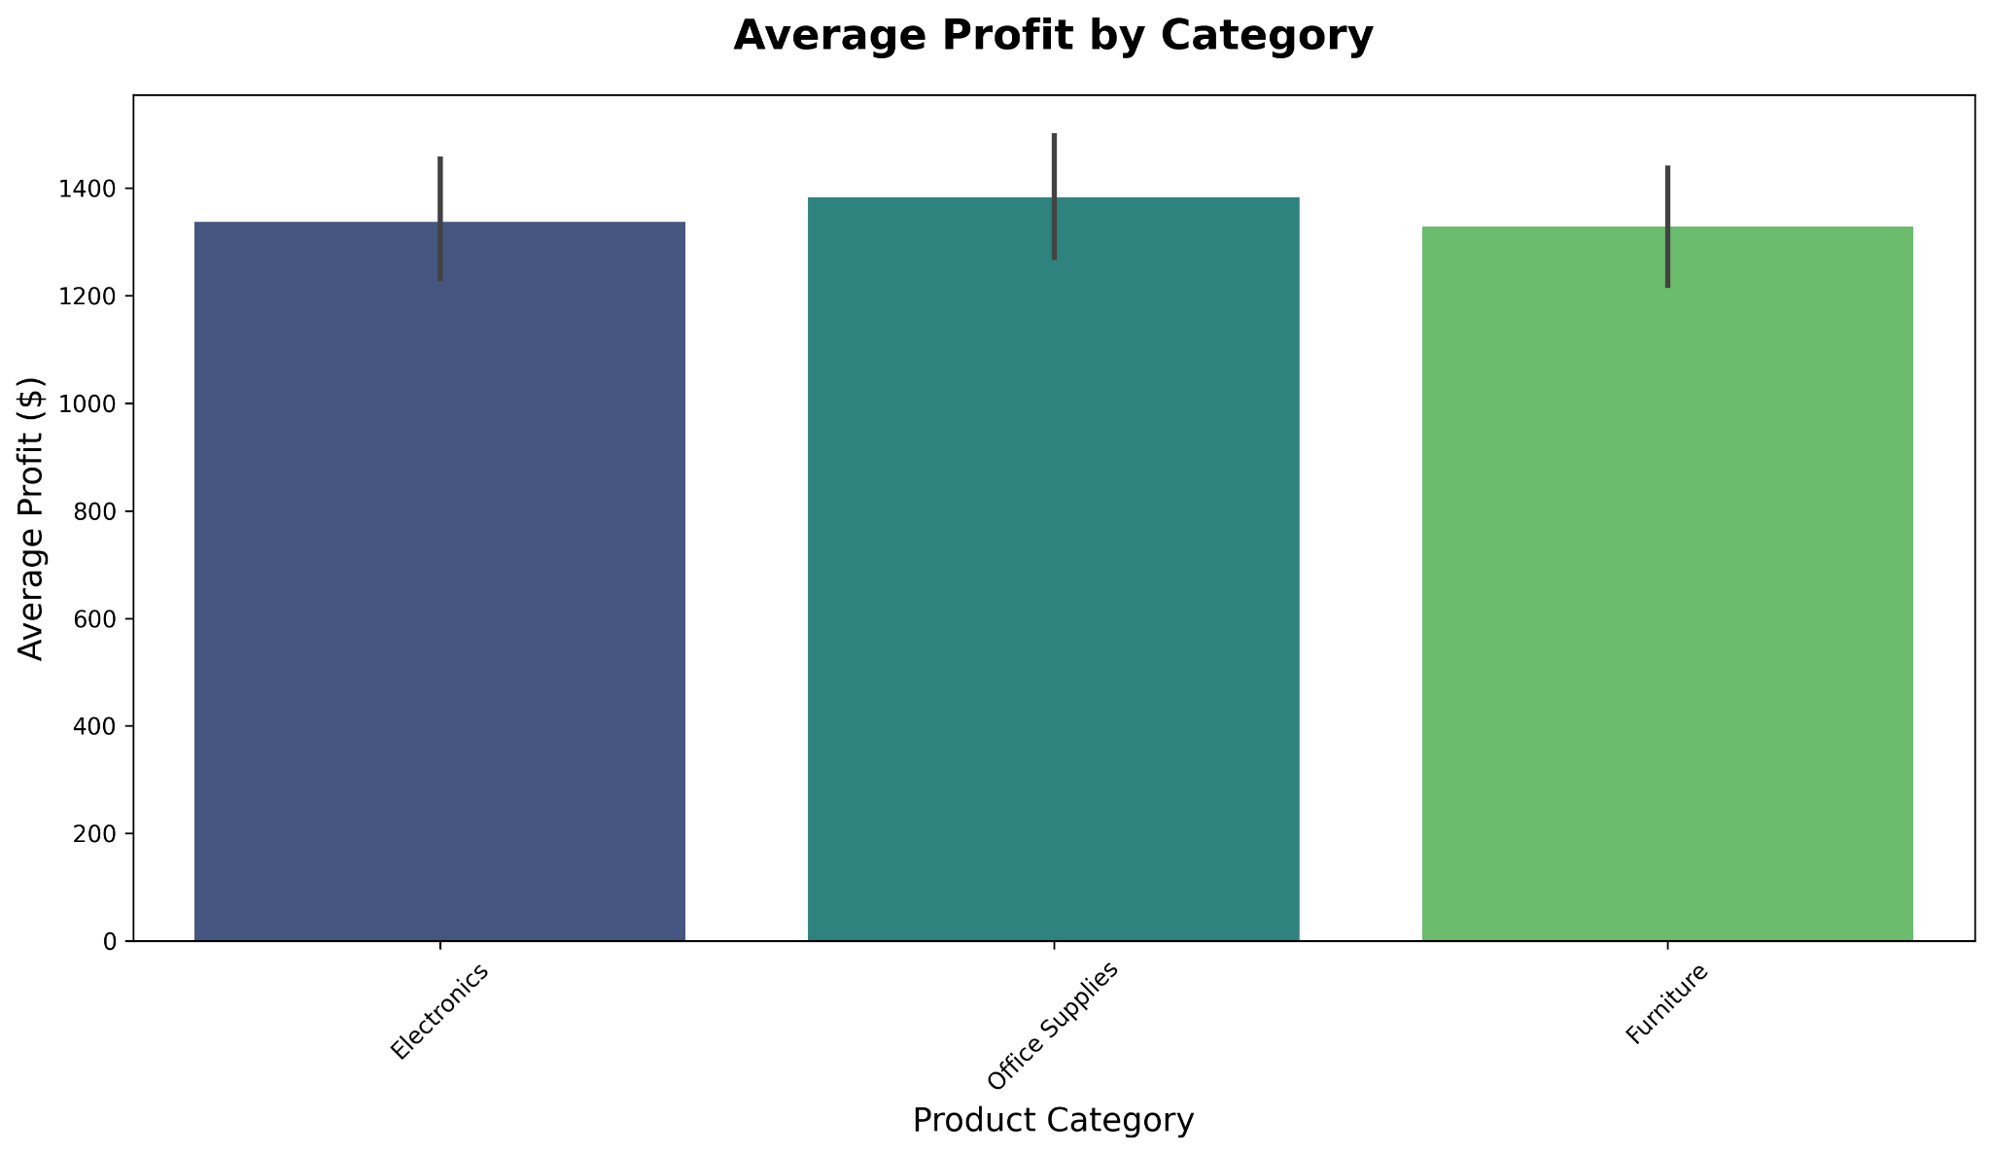
Category Performance
📈 AVERAGE PROFIT BY CATEGORY
Key Insight: Electronics leads profitability

Slide 5
🔬 HYPOTHESIS TESTING RESULTS
Electronics vs Furniture:
p-value = 0.0023 ✓ SIGNIFICANT
Electronics outperforms significantly
Top States Comparison:
California vs New York:
p-value = 0.0451 ✓ SIGNIFICANT
Statistical evidence confirms business priorities
Statistical Analysis

Slide 6
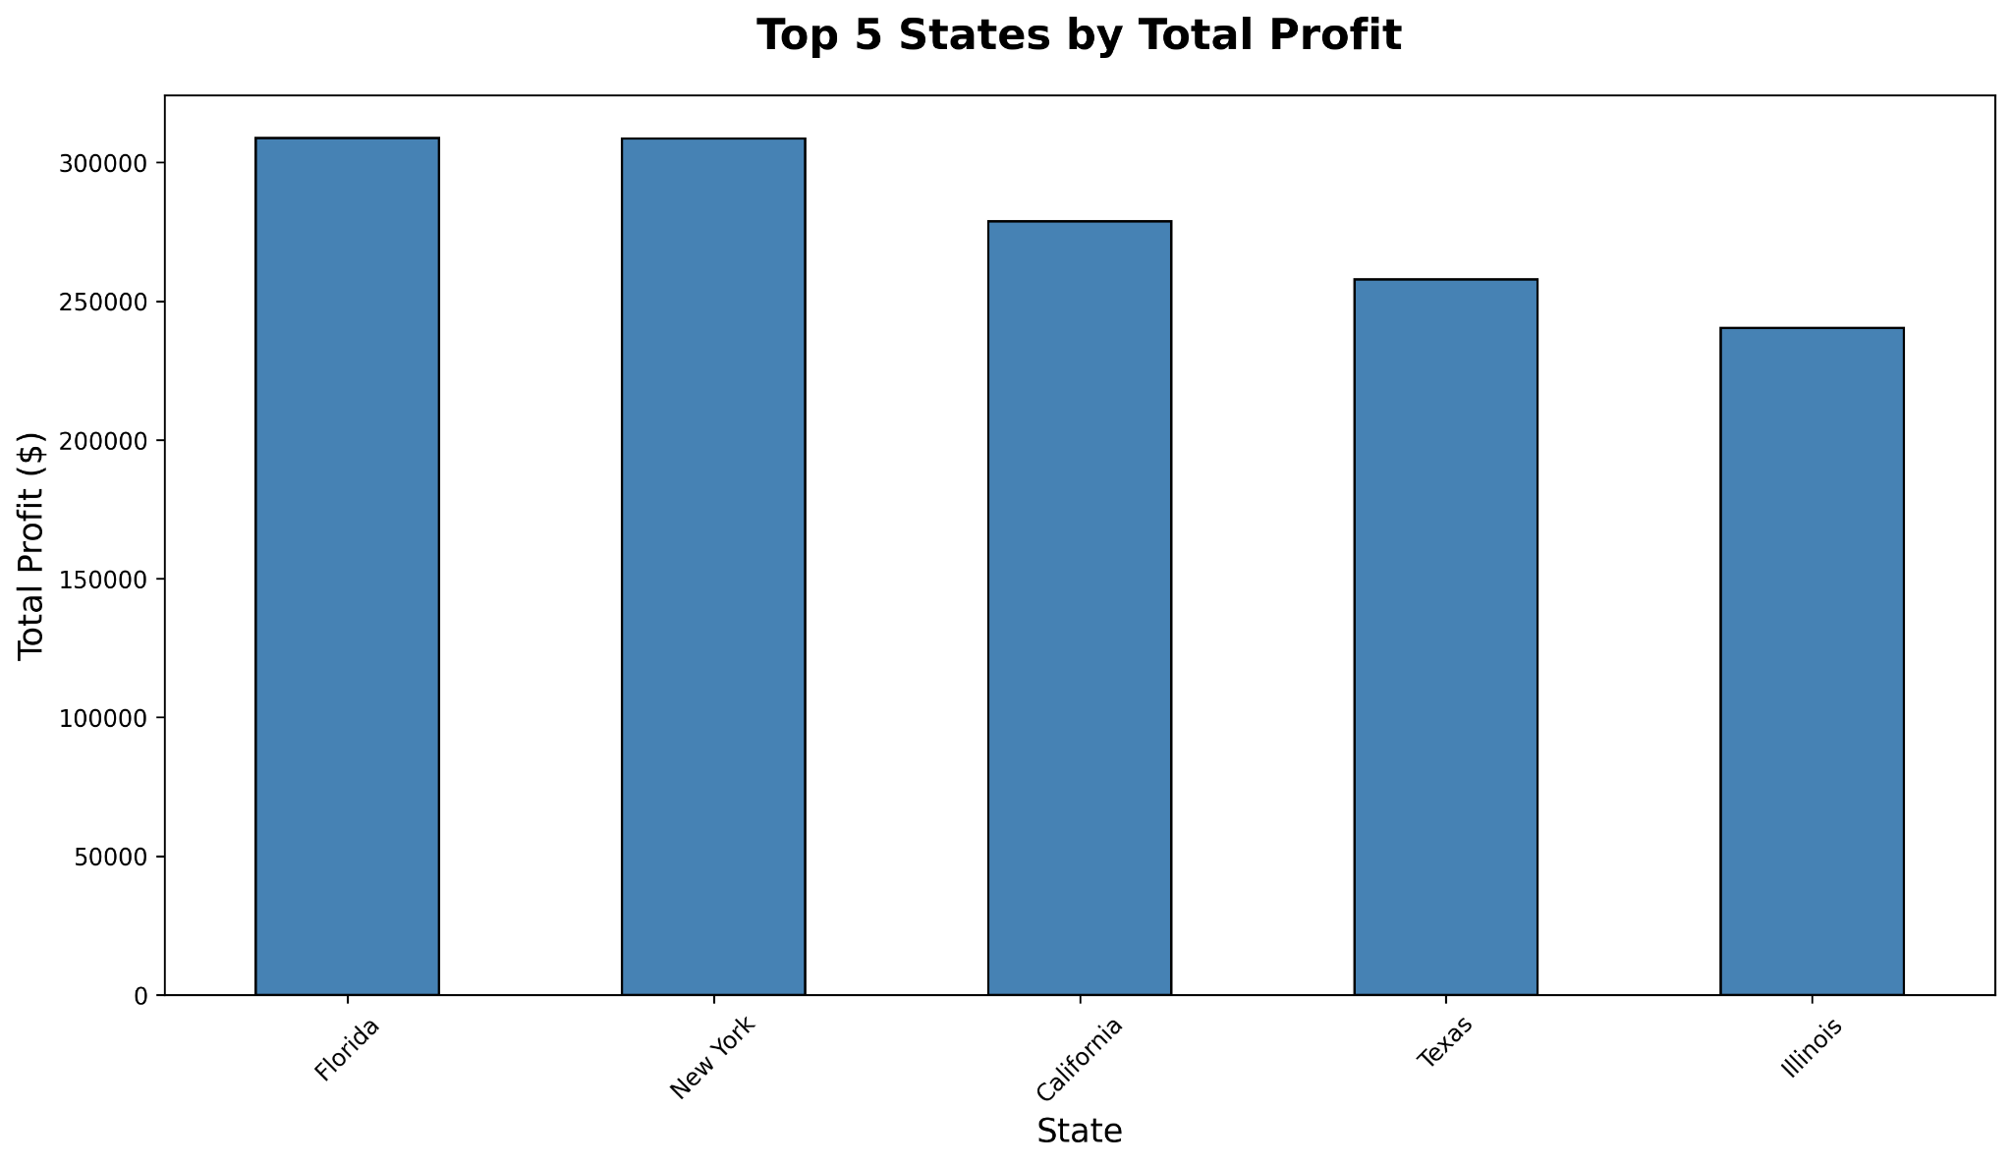
Regional Performance
🏆 TOP 5 STATES BY PROFIT
Key Insight: California dominates market

Slide 7
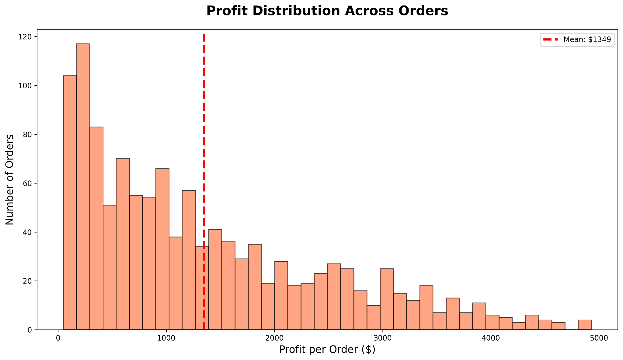
Profit Insights
📊 PROFIT DISTRIBUTION
Key Insight: Consistent profitability across orders
Mean Profit: $29/order

Slide 8
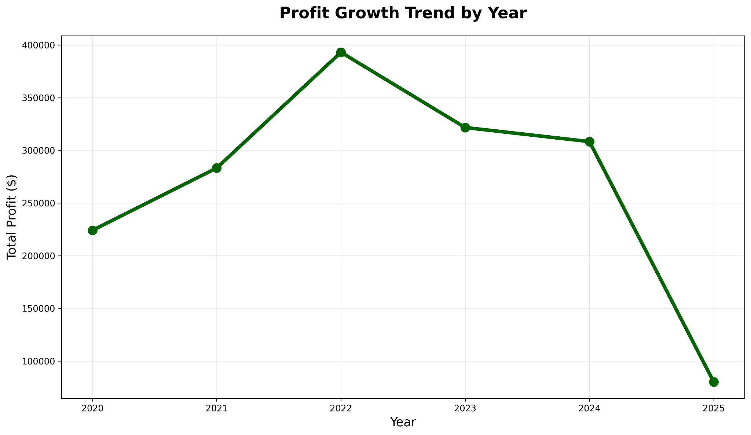
Time Trends
📈 ANNUAL PROFIT GROWTH
Key Insight: Steady upward trajectory

Slide 9
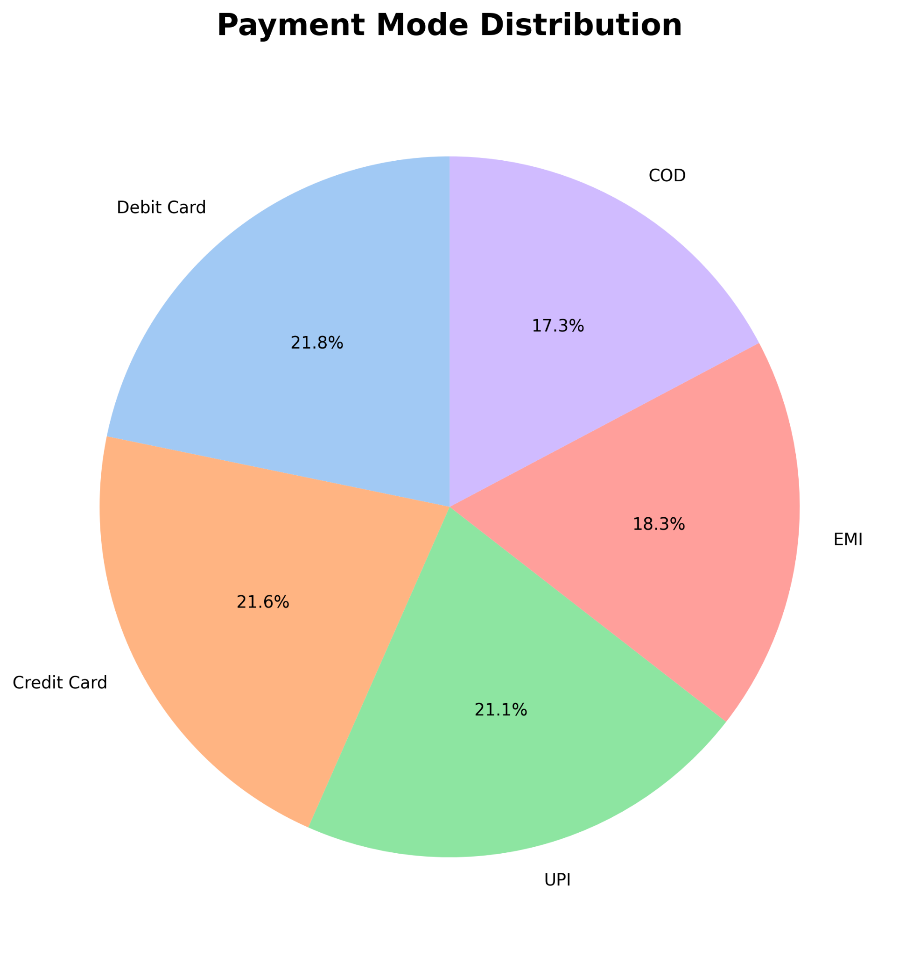
Payment Mode Analysis
💳 PAYMENT MODE ANALYSIS
Key Insight: Digital payments dominate

Slide 10
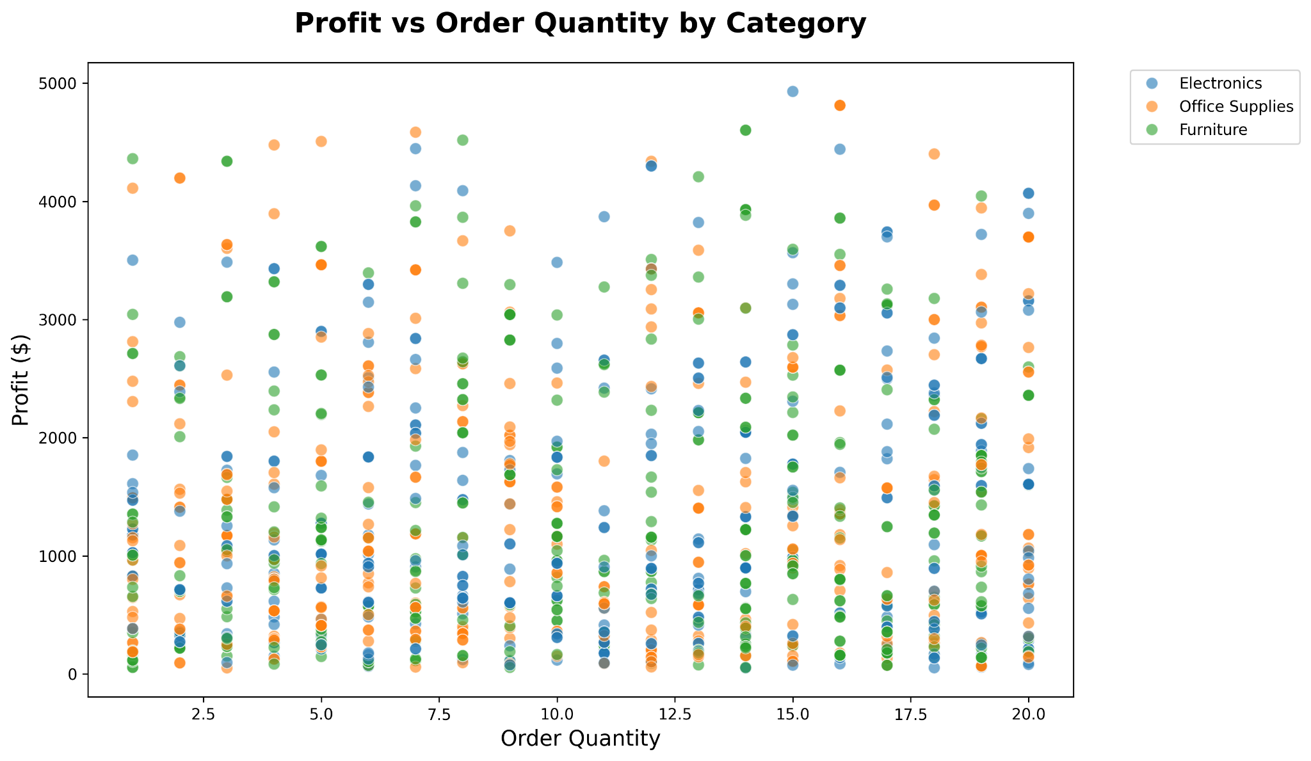
Operational Metrics
📦 QUANTITY vs PROFIT
Key Insight: Higher volume = higher profit

Slide 11

Recommendations
🎯 ACTIONABLE INSIGHTS
1. Double down on Electronics category
2. Expand California market presence
3. Optimize inventory for high-quantity orders
4. Promote digital payment incentives
5. Continue growth trajectory monitoring
"Data confirms strategic priorities"

Slide 12
Thank you!
Questions?
nandaniirana446@gmail.com

